Slide 1

STRAND | APNet 2026
Shielding Mobile Battery from Middlebox Timeouts
Server-driven zero-wakeup keep-alives
X. Sun, J. Zhang, J. Liang,
L. You, J. Li, J. Zhou

Slide 2
Idle CONNECTIONS can disappear in the network
PERSISTENT PATH
Push services keep mostly idle TCP connections so that a server can reach a sleeping application without establishing a new session.
Mobile Terminal
CGNAT/GTW
APP Server
Stage 1: Terminal Start TCP Connection
Initial Connection Establishment
NAT Table term created for terminal
IP | To | …
xxxx | 80
MIDDLEBOX STATE
Carrier-grade NATs, firewalls, and Wi-Fi gateways reclaim inactive mappings. Their idle timeout can be much shorter than the operating system's two-hour TCP keep-alive default.
Stage 2: Idle Caused by Long Connection
Connection idle
NAT table term eliminated
IP | To | …
xxxx | 80
Stage 3: Msg from Server No-longer Reachable
Message
No-longer reachable
SILENT-DROP
A mapping may be removed without FIN or RST. Both endpoints retain an ESTABLISHED socket, while later server data is discarded and recovery waits for retransmission or client-side detection.
How link is silently dropped in a long connection
STRAND | APNet'26
2

Slide 3
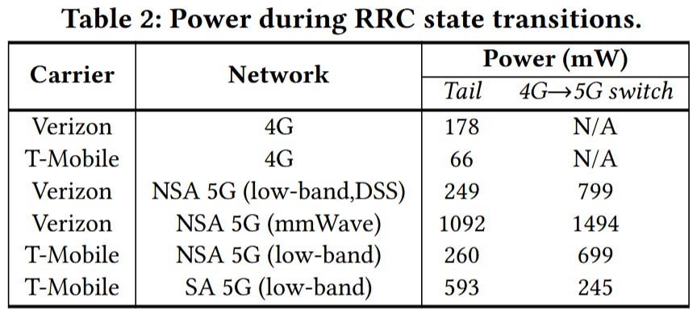
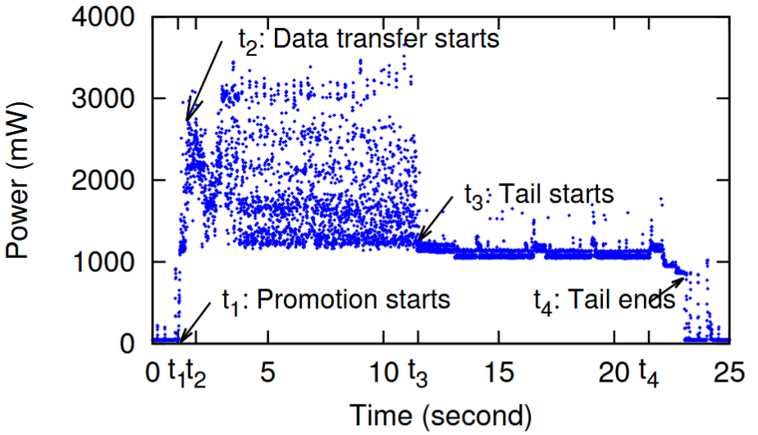
A small HEARTBEAT can trigger a full radio wake-up
CLIENT HEARTBEAT
An application sends periodic traffic before the middlebox timeout, refreshing the mapping through the complete end-to-end path.
RADIO STATE TRANSITION
Even an empty ACK can move a cellular modem from RRC_IDLE to RRC_CONNECTED. A network-configured tail interval can keep it active for roughly 10-15 seconds.
ENERGY MODEL
The cost is governed mainly by wake-up frequency and tail time, rather than by the heartbeat payload. Wi-Fi also exposes periodic traffic to system wake-up and batching policies.
Energy consumption of radio wake-up is significant for battery-critical applications
STRAND | APNet'26
3

Slide 4
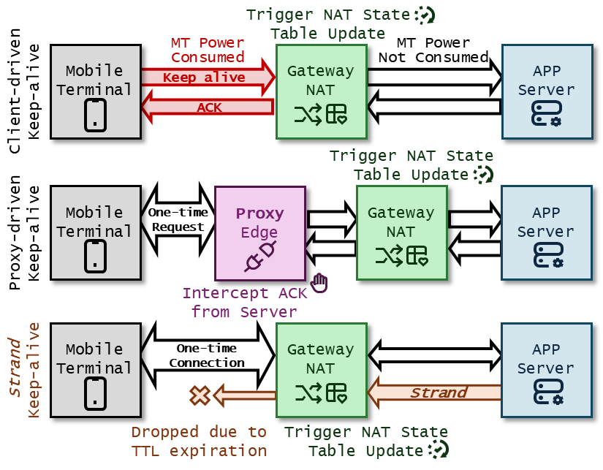
LIVE STRANDING: refresh the gateway, stop before the phone
OBSERVATION
A stateful gateway refreshes a mapping when a packet with the matching five-tuple enters its processing path; end-to-end delivery is not required for that state update.
TTL TRUNCATION
Let N be the downstream hop count to the client. Strand injects a zero-payload packet with TTL = N - 1, so it reaches the final gateway and expires during forwarding.
OUTCOME
The gateway updates the mapping, while the packet does not cross the last wireless hop. The phone remains asleep and the application sees no keep-alive event.
Energy Consumption of Radio Wake-up is Significant for Battery-critical Applications
STRAND | APNet'26
４

Slide 5
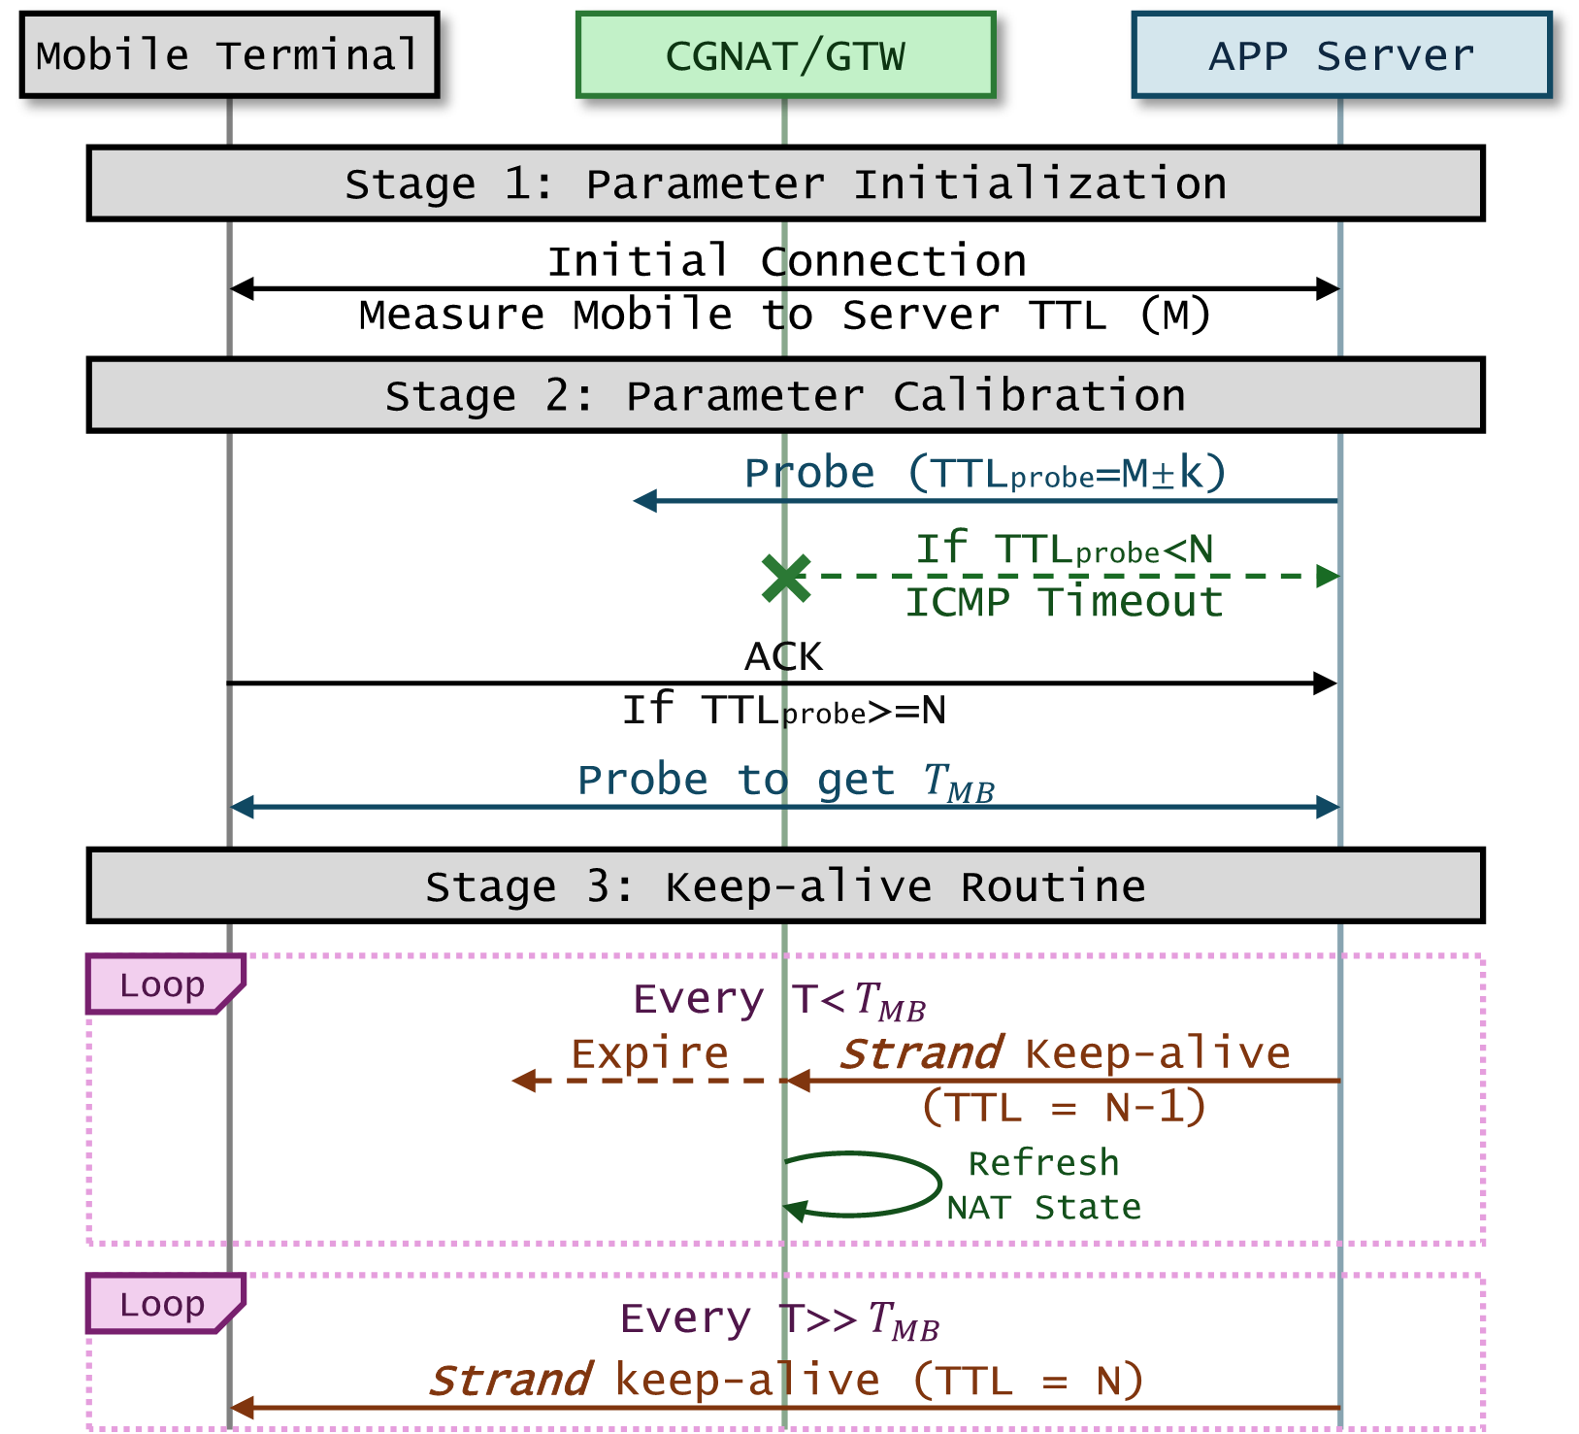
The server calibrates WHERE abd WHEN to send
01 INITIALIZE
Observe the client's incoming TTL during connection setup and estimate the upstream hop count M.
02 CALIBRATE
Probe around M to find the minimum downstream TTL N that elicits a TCP ACK. Separately estimate the middlebox timeout T_MB.
03 MAINTAIN
Send truncated packets at an interval below T_MB. Use infrequent end-to-end checks to detect route changes or disconnected clients.
Energy Consumption of Radio Wake-up is Significant for Battery-critical Applications
STRAND | APNet'26
５

Slide 6


Timeout discovery is a search with waiting as its cost
TEMPORAL PENALTY
DISCRETE PRIOR
WEIGHTED DP
Testing whether a timeout exceeds t requires an actual idle wait of t. Composite Search bounds the range exponentially, then applies binary refinement, accumulating long waits at larger values.
Observed TCP and UDP timeout settings cluster around vendor and operator defaults. Strand models a bounded domain with probability mass assigned to measured hotspot values.
Dynamic programming chooses increasing probe boundaries that minimize expected physical waiting time, including the cost of later binary refinement within a failed interval.
$$dp\left[t\right]=min_{s}\left\{dp\left[s\right]+Pr\left(T>s\right)∗c_{t}+BS\left(s+1,t−1\right)\right\}$$
STRAND | APNet'26
6

Slide 7
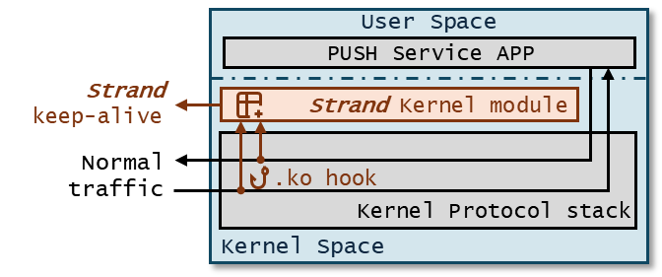
Implementation stays on the server side
KERNEL MODULE
A hot-pluggable Linux module uses kprobe and kretprobe hooks to observe socket context and packet-processing events without changing the push application.
PACKET INJECTION
The module constructs raw zero-payload TCP packets, sets the intended TTL, and bypasses sequence tracking and retransmission queues.
COMPATIBILITY PATH
Stale-sequence probes rely on RFC 9293 ACK behavior. Hook removal or failed consistency checks restore the existing keep-alive path.
Kernel-module position in the server stack
STRAND | APNet'26
7

Slide 8
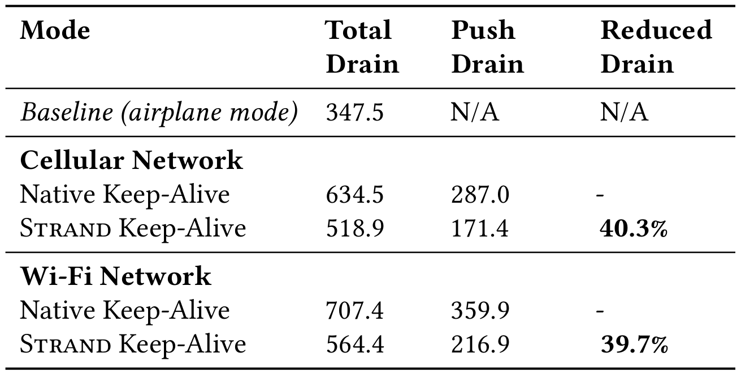
Evaluation: 24-hour mobile power measurements
SETUP
CELLULAR
ENTERPRISE WI-FI
Four phones of one model; five 24-hour runs; airplane-mode drain subtracted as the background baseline.
Push drain changed from 287.0 to 171.4 mAh, a reported reduction of 40.3%.
Push drain changed from 359.9 to 216.9 mAh, a reported reduction of 39.7%.
Kernel-module position in the server stack
STRAND | APNet'26
8

Slide 9
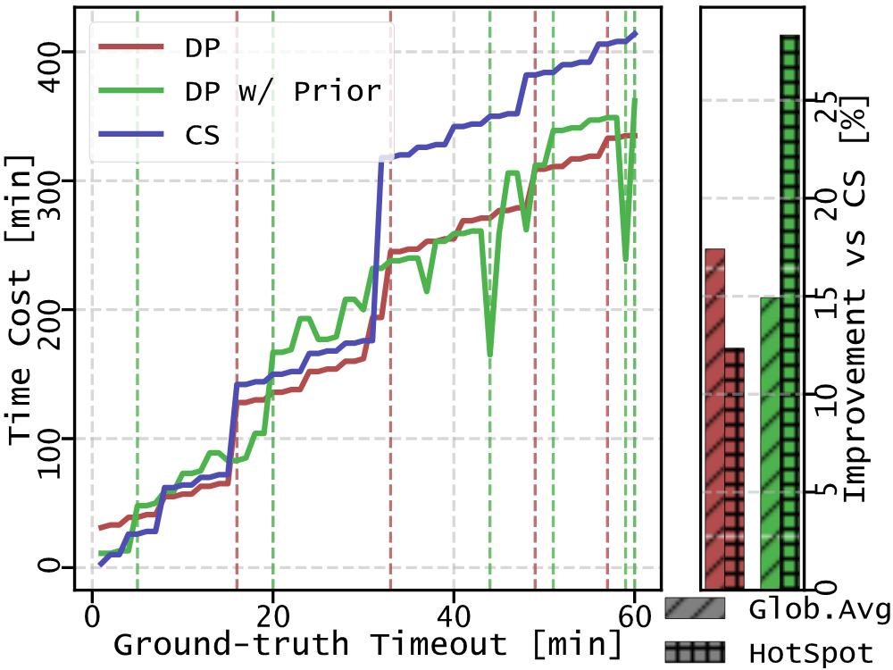
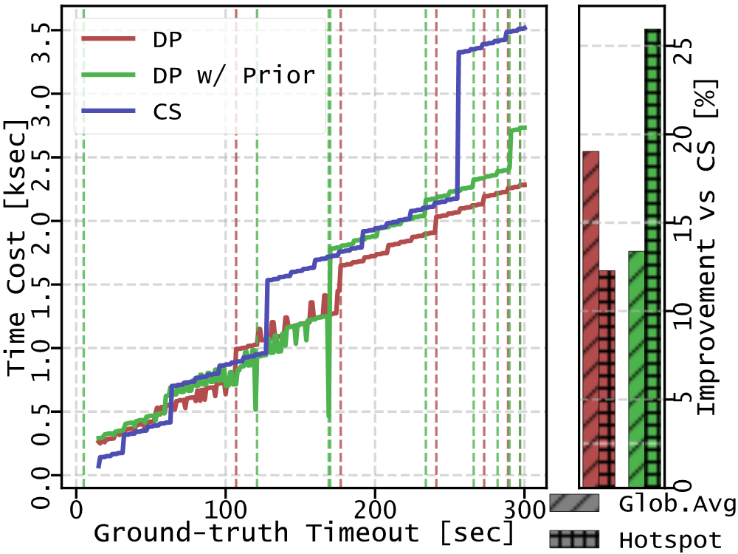
Evaluation: timeout probing convergence
Composite Search (CS), unweighted DP, and DP with measured timeout priors
Average reduction vs. CS: 18% TCP and 19% UDP; hotspot reduction: 28% TCP and 26% UDP.
STRAND | APNet'26
9

Slide 10
STRAND changes who maintains state, not the need for state
COST TRANSFER
01
OPERATING BOUNDARY
02
INFRASTRUCTURE
03
Maintenance moves upstream
Fallback remains part of the design
Network evolution can remove the cause
Strand does not remove state maintenance. Routine keep-alive packets and packet construction move from battery-constrained clients to push servers and gateway processing.
Deployment therefore needs capacity planning for per-connection scheduling, outbound traffic, and metering policy.
TTL truncation assumes connection tracking runs before TTL expiry and that the route boundary remains stable.
Low-frequency end-to-end checks detect route changes, non-standard gateways, and disconnected clients. Failed checks trigger recalibration or restore client-driven maintenance.
The mechanism addresses short idle timeouts in IPv4 and heterogeneous paths.
Broader IPv6 deployment and deterministic port allocation can reduce per-flow NAT pressure, permit longer idle lifetimes, and reduce the need for server-side intervention.
TAKEAWAY
Middlebox state can be maintained without making every packet a radio event.
STRAND | APNet'26
10

